Slide 1


Slide 2
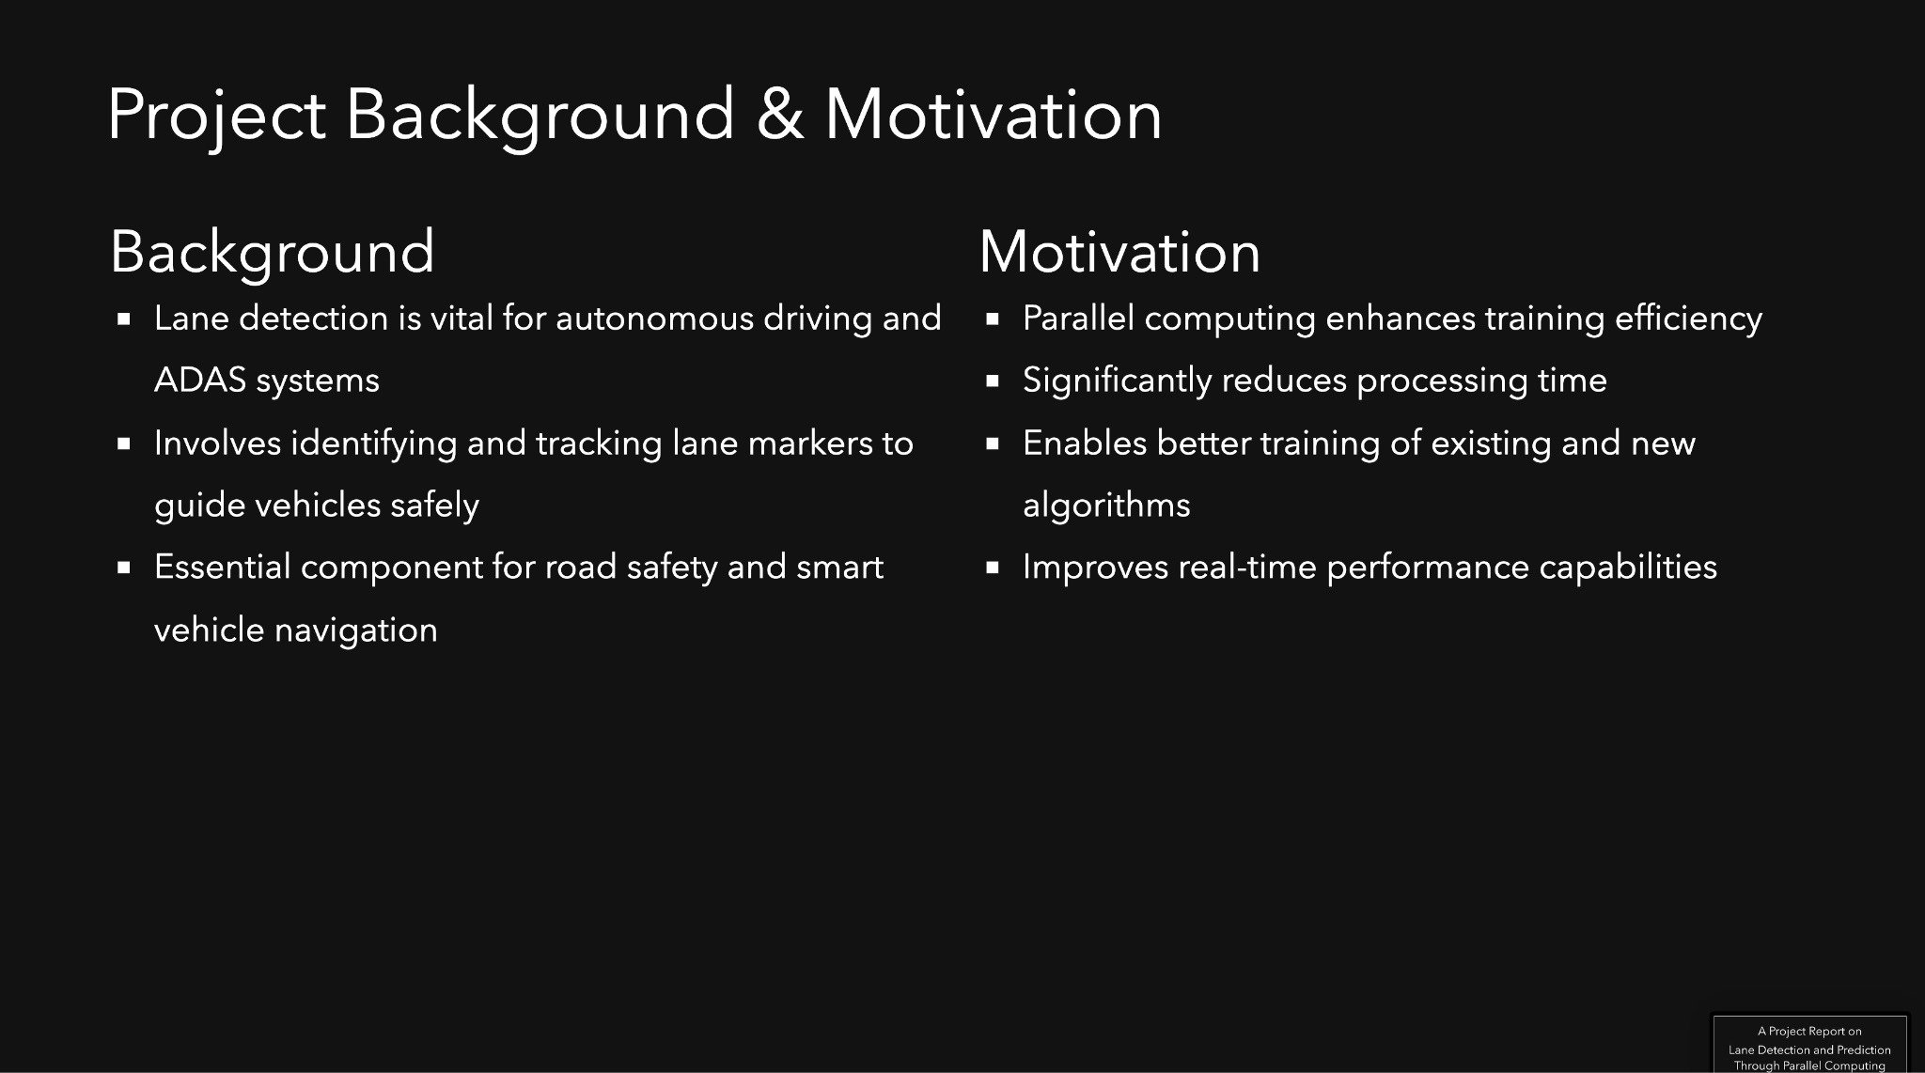

Slide 3
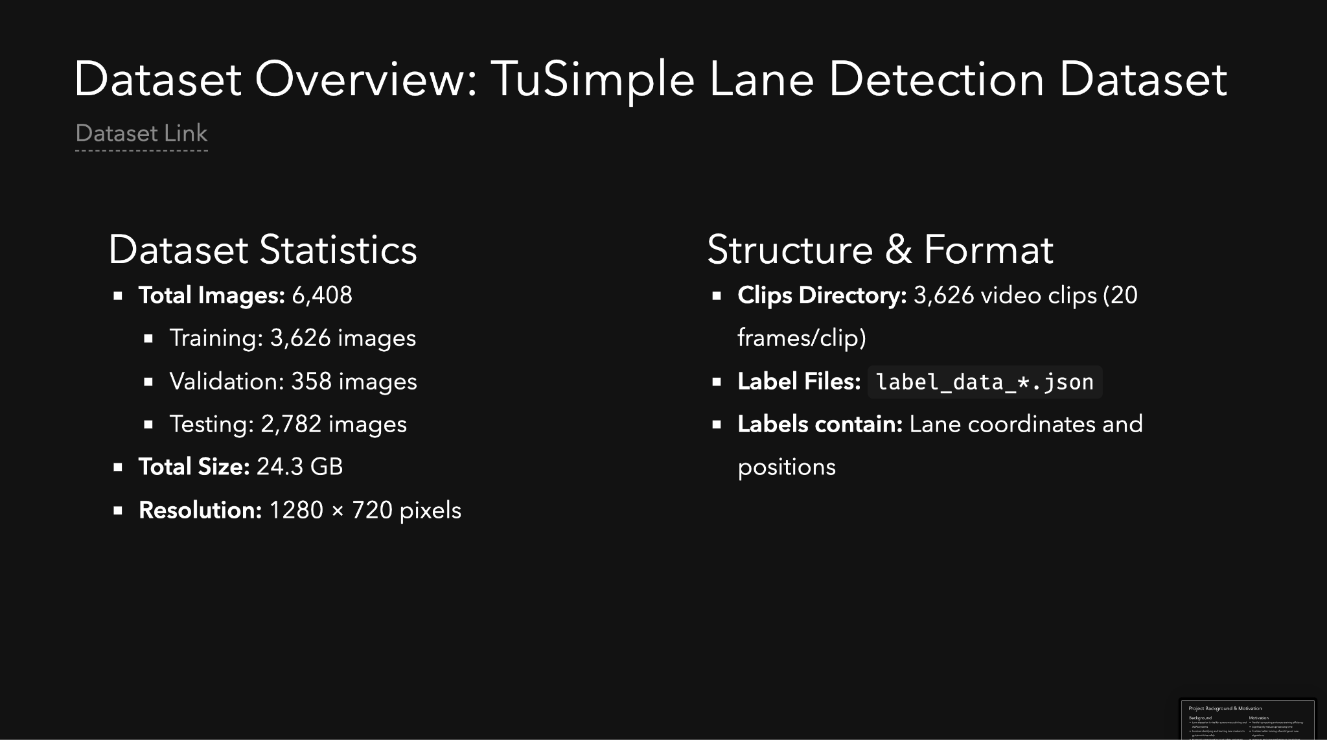
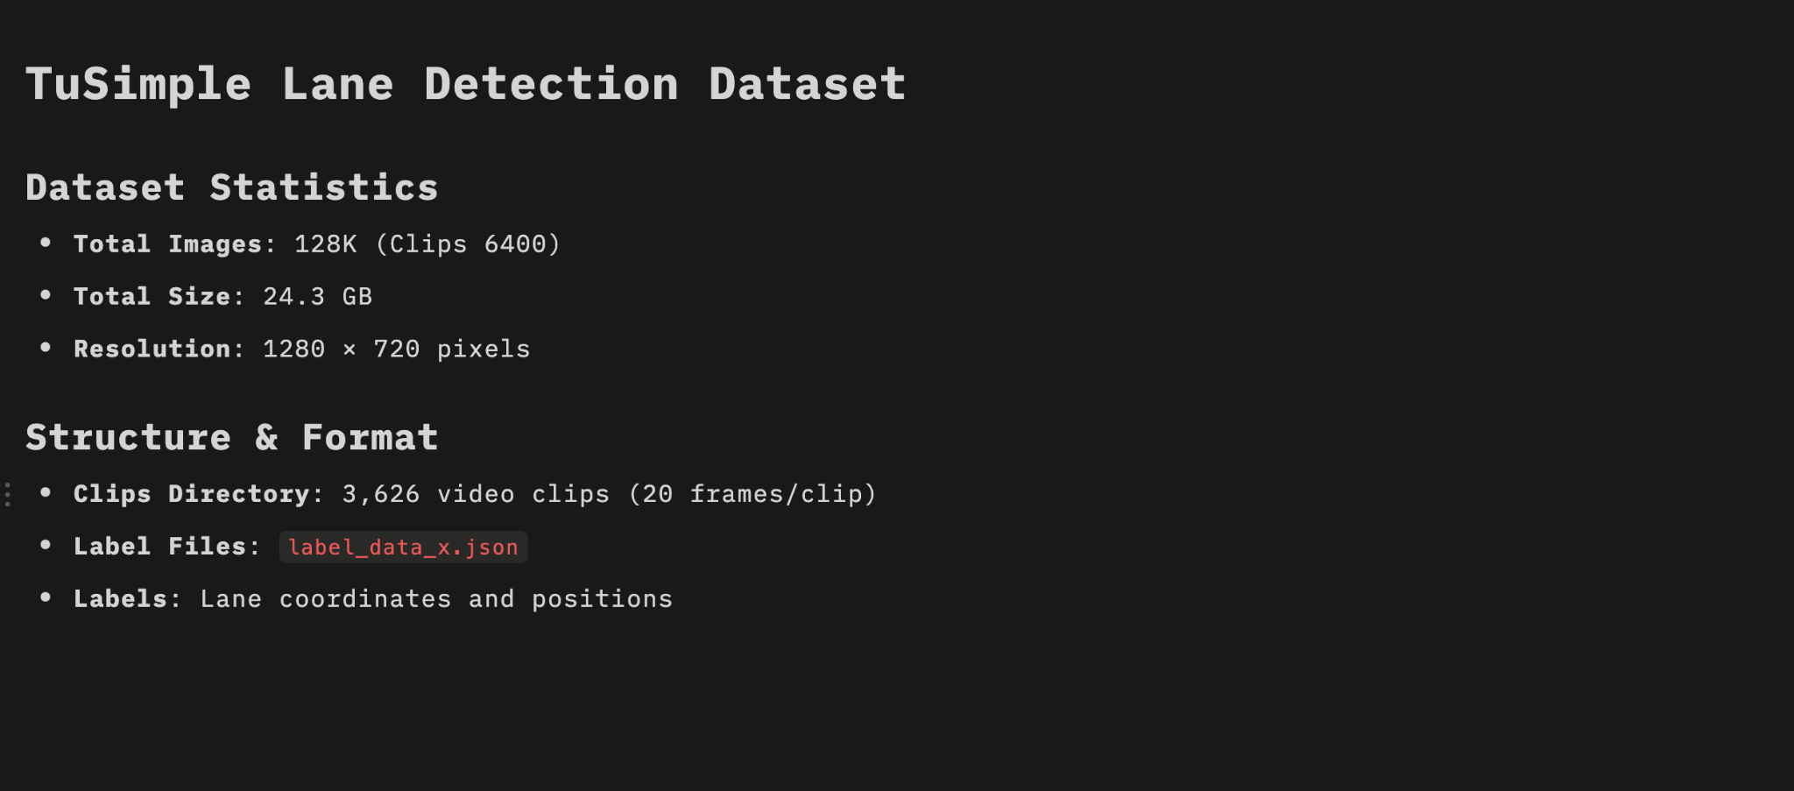

Slide 4
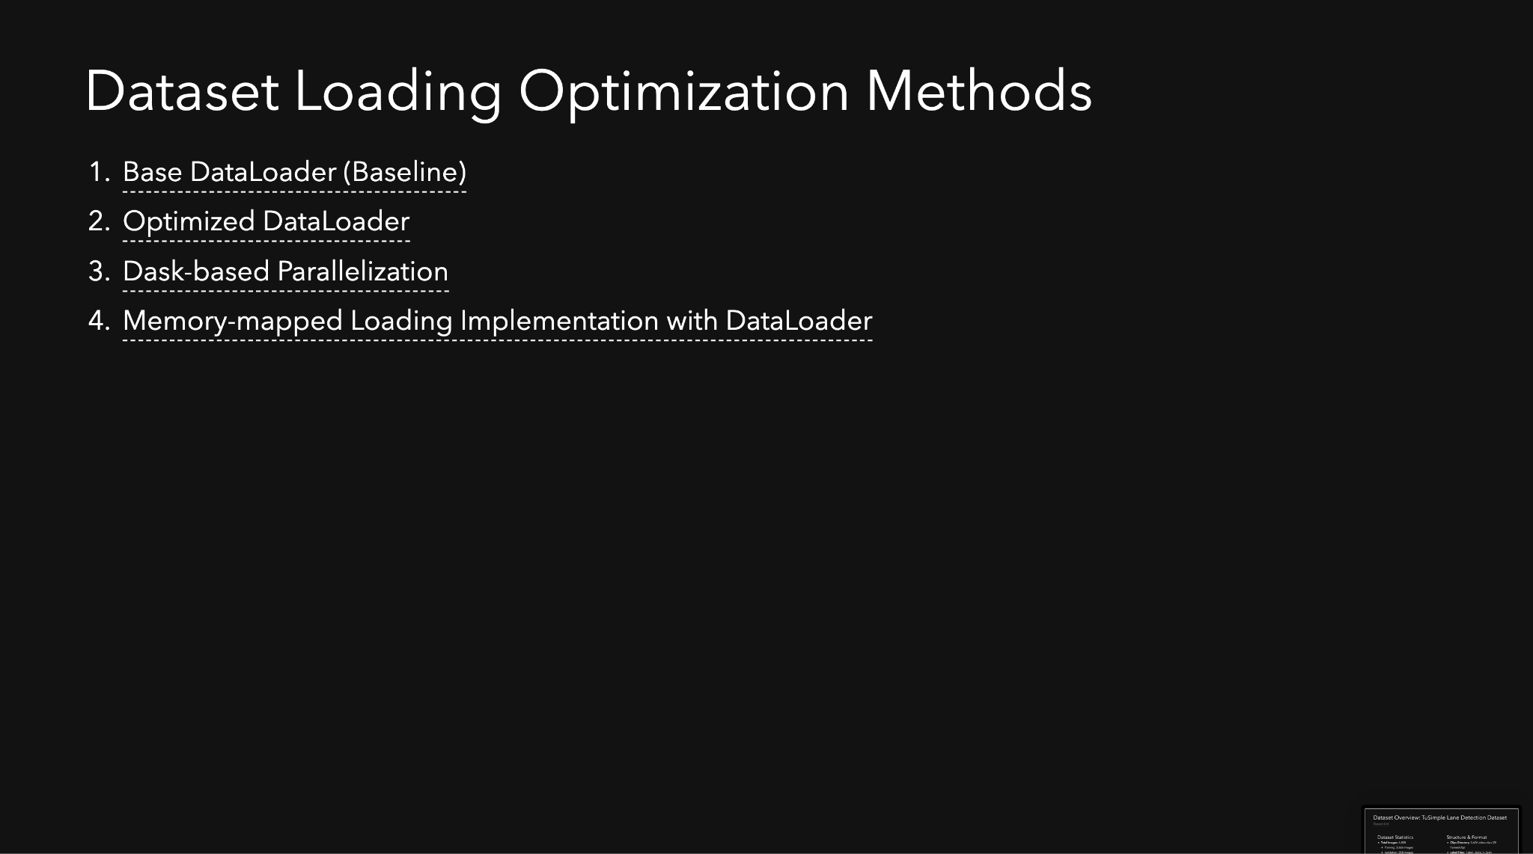

Slide 5
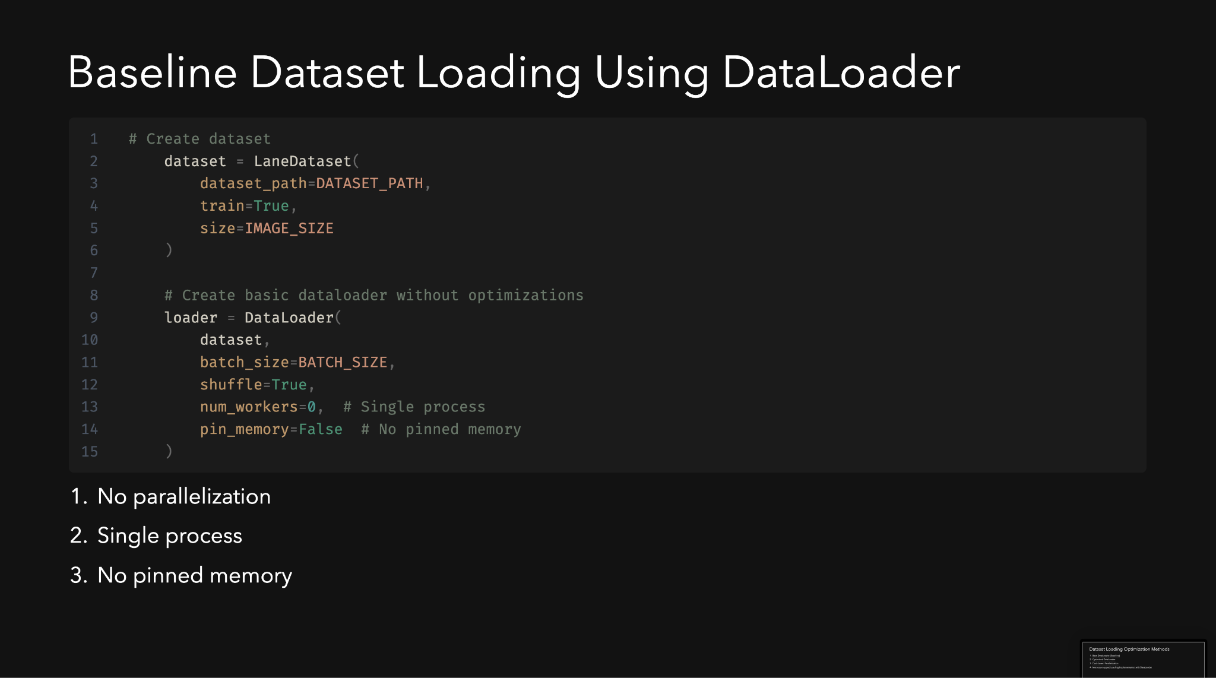

Slide 6
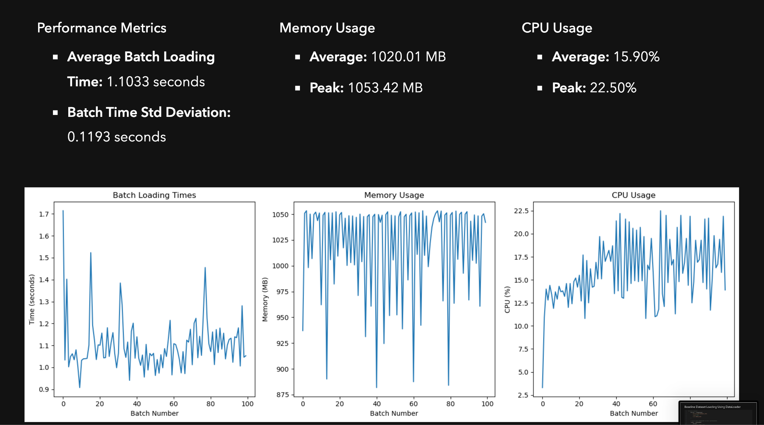

Slide 7
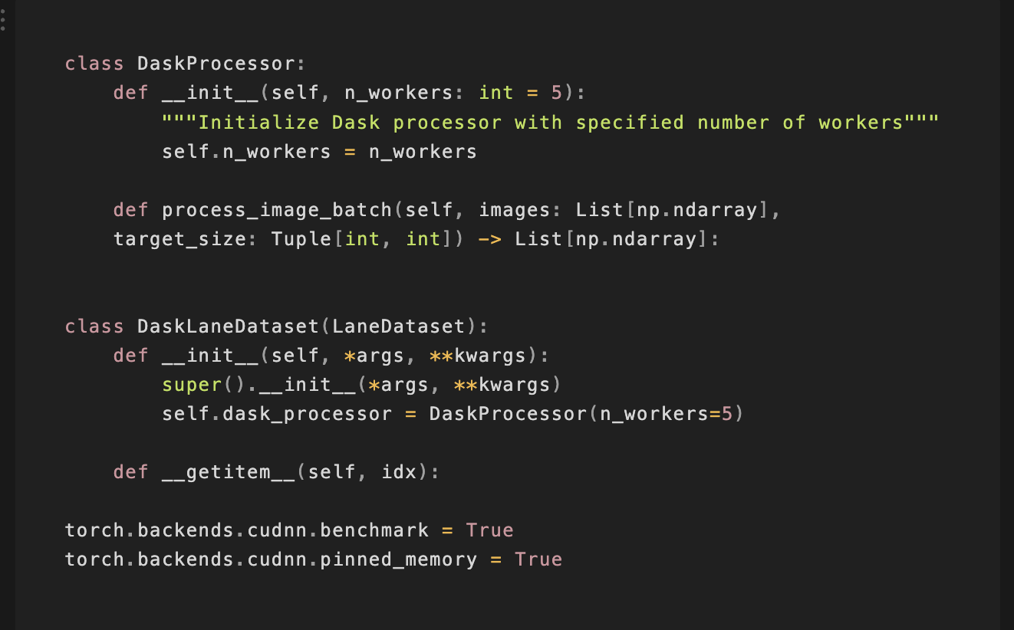
DASK-based Parallelization
Dask Configuration Analysis
Parallel Processing Setup
- Utilizes Dask's distributed computing capabilities with 5 workers for parallel image processing
- Implements chunk-based processing using `da.from_array` with automatic chunk size determination
- Combines parallel processing with DataLoader's built-in multiprocessing (5 workers) for nested parallelism
Memory Optimization
- Uses pinned memory (`pin_memory=True`) for faster CPU to GPU transfers
- Implements prefetching with `prefetch_factor=2` to load future batches in advance
- Maintains persistent workers to reduce process creation overhead
Image Processing Pipeline
- Processes images in batches using Dask arrays for parallel computation
- Performs automatic format conversion (grayscale to RGB) and size normalization
- Implements efficient memory mapping through Dask's lazy evaluation system

Slide 8
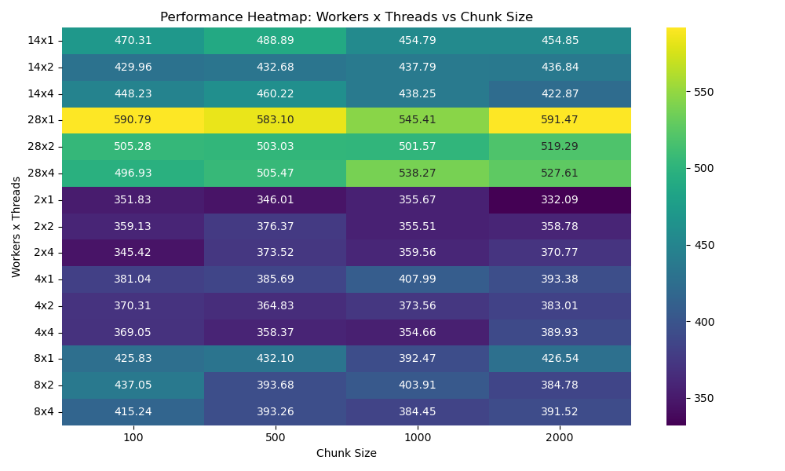

Slide 9
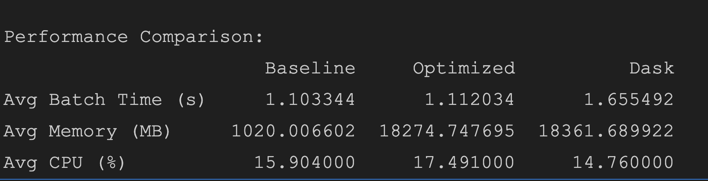
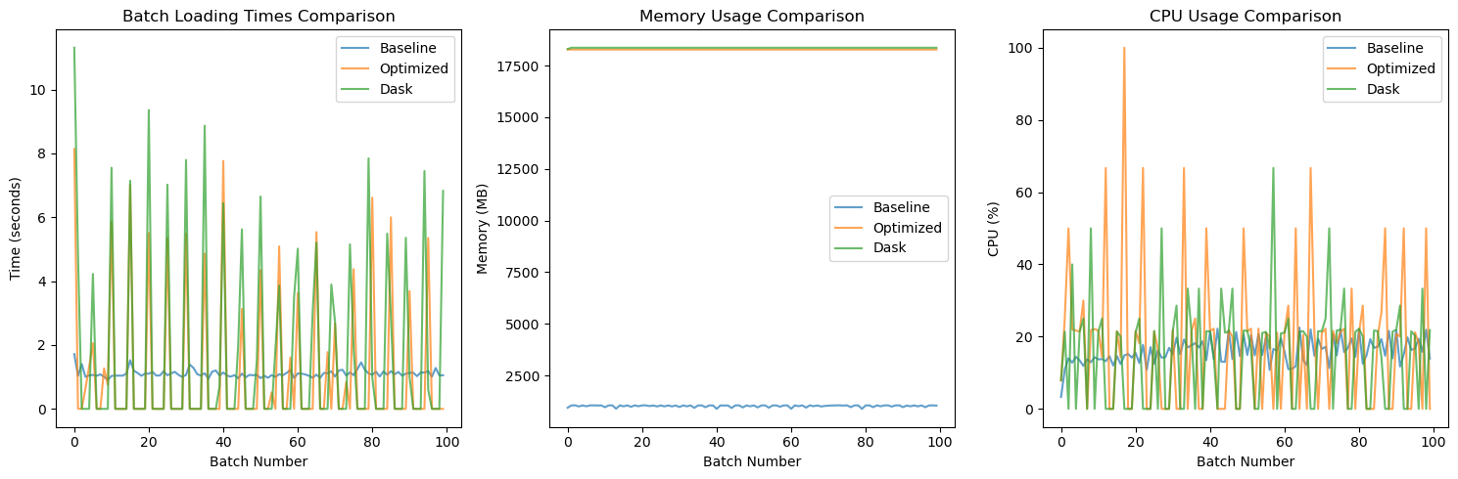
Loading time reduction: -50.04%
Memory Usage Reduction: -1700.15%
CPU Utilization Increase: 7.19%

Slide 10
Dask Resource Optimization Recommendations
Worker & Thread Configuration
- Use 2-4 threads per worker
- Scale workers up to 8 for optimal balance
- Avoid single-threaded setups
Resource Management
- Prefer chunk sizes 1024-2048
- Monitor memory usage per worker
- Test worker-thread ratios for workload
Performance Optimization
- Reduce communication overhead
- Balance memory allocation
- Fine-tune based on workload type
Best Practices
- Start with 4×4 or 8×2 configurations
- Evaluate scaling beyond 8 workers
- Monitor resource contention

Slide 11
Dask parallelization doesn't provide benefits in this case, likely due to:
Overhead of Dask's distributed computing setup
Additional serialization/deserialization costs
Memory management overhead
The optimized PyTorch DataLoader remains the better choice so far.

Slide 12
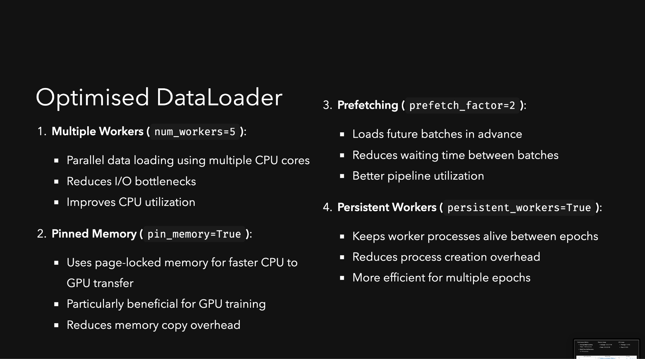

Slide 13
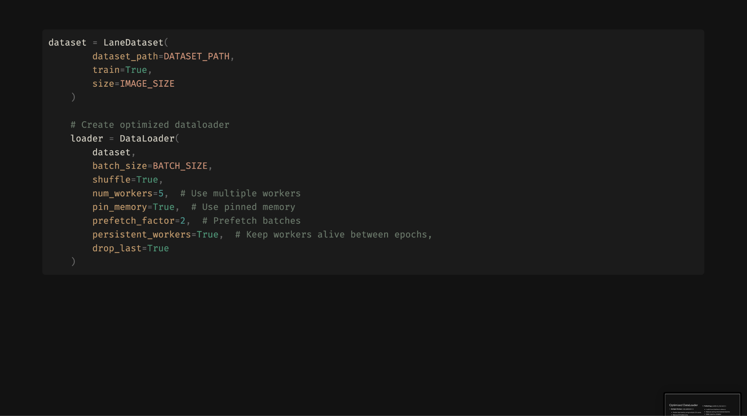

Slide 14
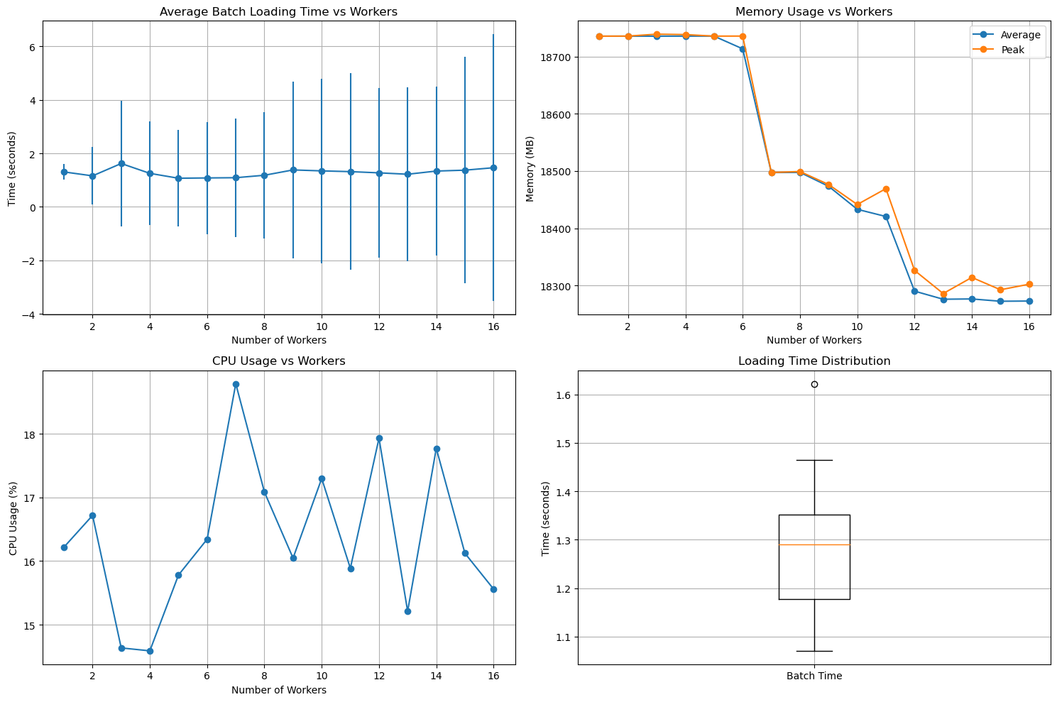

Slide 15
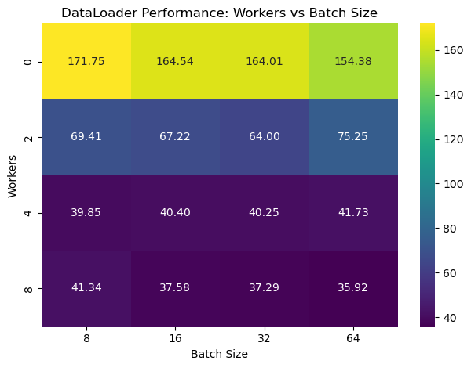
Notes:
Increasing the number of workers leads to significant improvements in dataloader efficiency, with diminishing returns beyond 4 workers.
Larger batch sizes are handled efficiently with higher worker configurations, but the performance gains are minimal compared to the impact of increasing workers.
For workloads requiring real-time or near-real-time performance, using at least 4 workers is recommended.

Slide 16
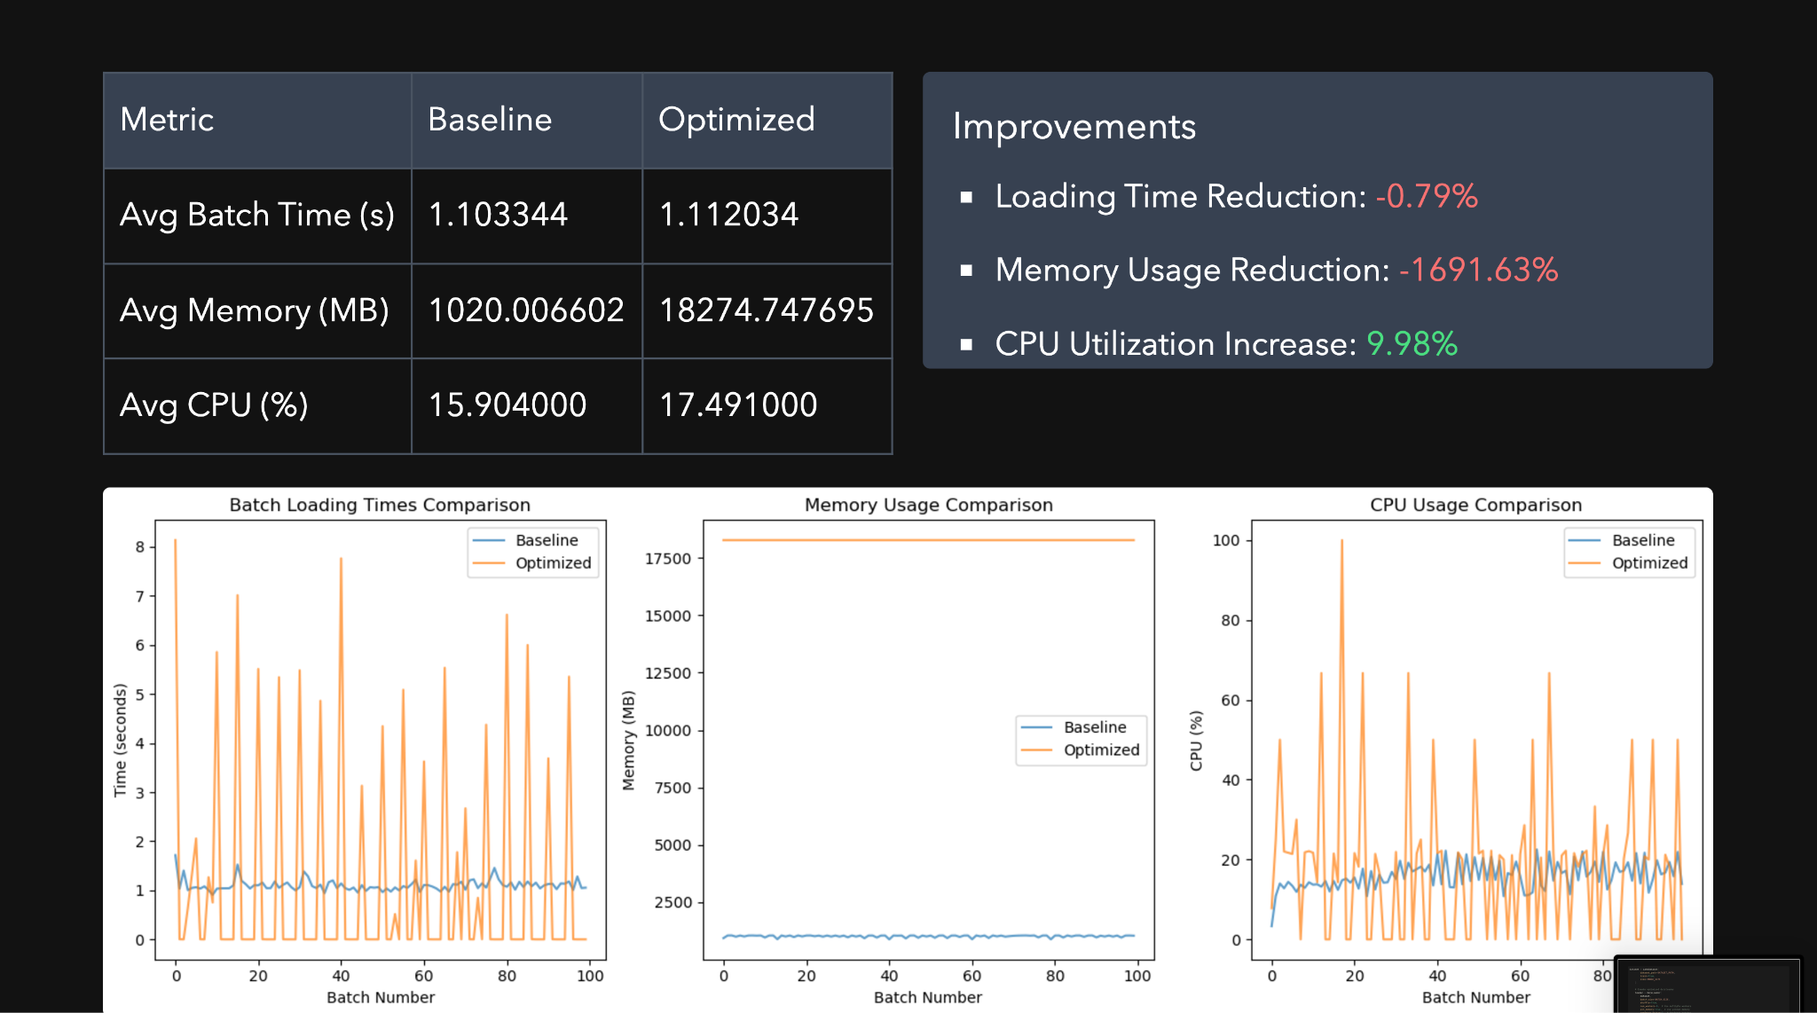

Slide 17
Excessive Memory Usage:
A combination of num_workers=5, prefetch_factor=2, and pinned memory causes each worker to allocate large, unreleased memory, leading to a dramatic increase from ~1GB to ~18GB.
2. Erratic Batch Loading Times:
Memory thrashing due to high memory usage causes inconsistent loading times, ranging from ~0.5 to ~8 seconds.
3. Inefficient CPU Utilization:
Excessive memory overhead forces the CPU to spend more cycles on memory management rather than processing, resulting in only a 9.98% increase in utilization despite multiple workers.

Slide 18
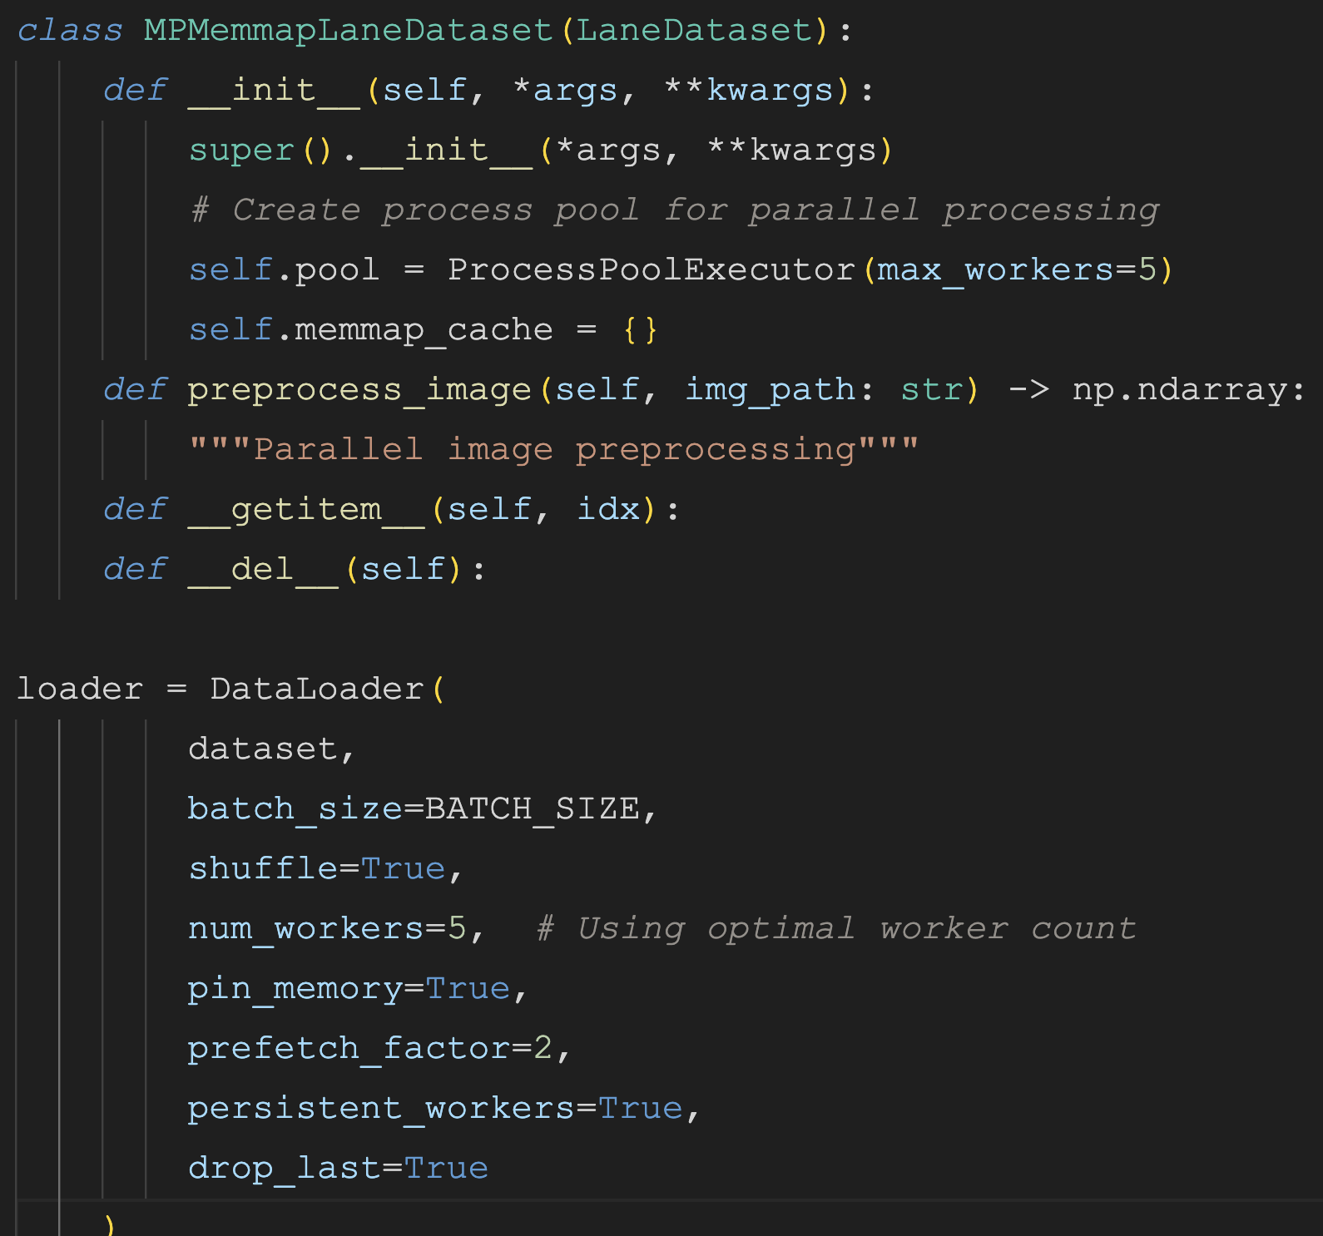
Memory-mapped Loading With Optimised Data Loader
1. The implementation uses a two-tier caching system:
- Memory mapping (memmap_cache) stores preprocessed images in virtual memory files
- Process pool handles parallel preprocessing of uncached images
2. The architecture provides:
- Disk-backed storage of preprocessed data via memory mapping
- Parallel preprocessing for new images
- Shared memory access across worker processes
- Fast random access to cached data
3. When accessing an image:
- First checks memmap cache
- If missing, preprocesses in parallel and caches result
- Subsequent accesses read directly from memmap
- Avoids redundant preprocessing and memory duplication
Notes:
Memory Mapping
Memory mapping creates a direct correlation between a file on disk and a segment of virtual memory1. When dealing with large files like preprocessed images:
It allows "lazy loading" - only loading the needed portions of data into RAM
Provides efficient access by loading data in optimized page-sized chunks
Enables multiple processes to share the same mapped memory3

Slide 19
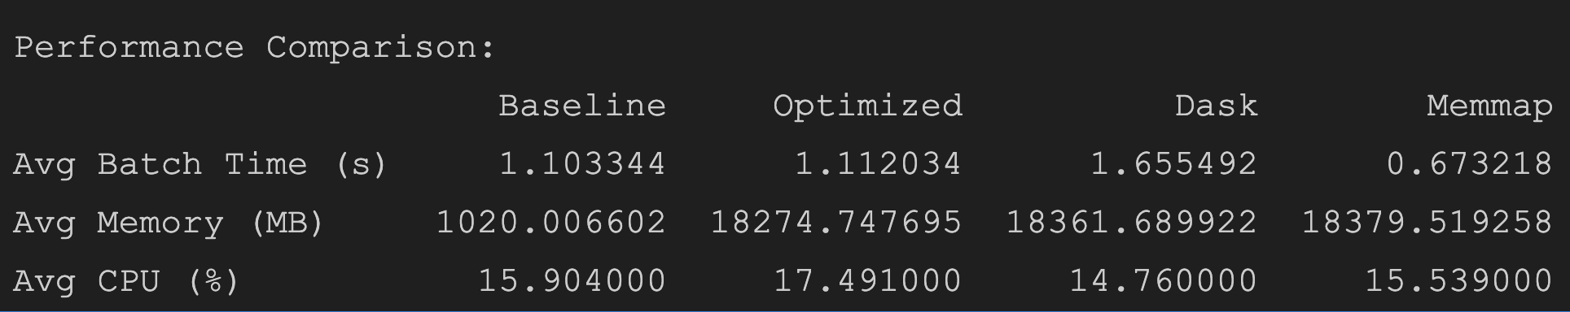
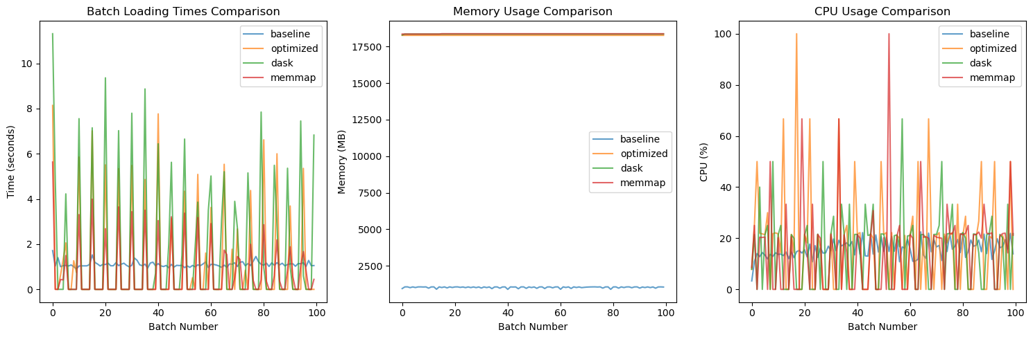
Loading time reduction: +50.00%
Memory Usage Increase: +94.45%
CPU Utilization Increase: 7.20%

Slide 20
1. Operational Stability:
- While memmap showed better average batch loading times (0.67s vs 1.11s), the optimized loader demonstrated more consistent performance
- This stability is crucial for production environments where predictable performance is often more valuable than raw speed
2. Resource Management:
- Though baseline used less memory (~1GB), the optimized version's higher memory usage (~18GB) was a calculated tradeoff
- The consistent memory usage pattern in the optimized version suggests better resource predictability
- CPU utilization showed a moderate increase (17.49% vs 15.9% baseline) without excessive overhead
3. Implementation Complexity vs Benefits:
- The optimized loader achieved significant performance improvements without the complexity of memory mapping
- Traditional optimization techniques (like prefetching and pinned memory) provided reliable performance gains
- The simpler architecture makes it easier to maintain and debug compared to memmap or Dask implementations
This balanced approach between performance, stability, and maintainability made the optimized data loader the most practical choice for production use.

Slide 21
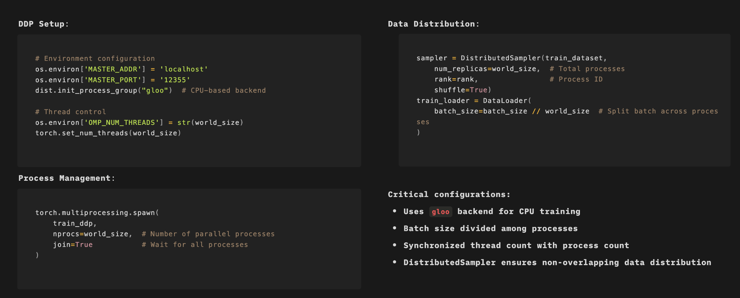
Distributed Parallel Training Implementation with: PyTorch DDP on CPU Setup

Slide 22
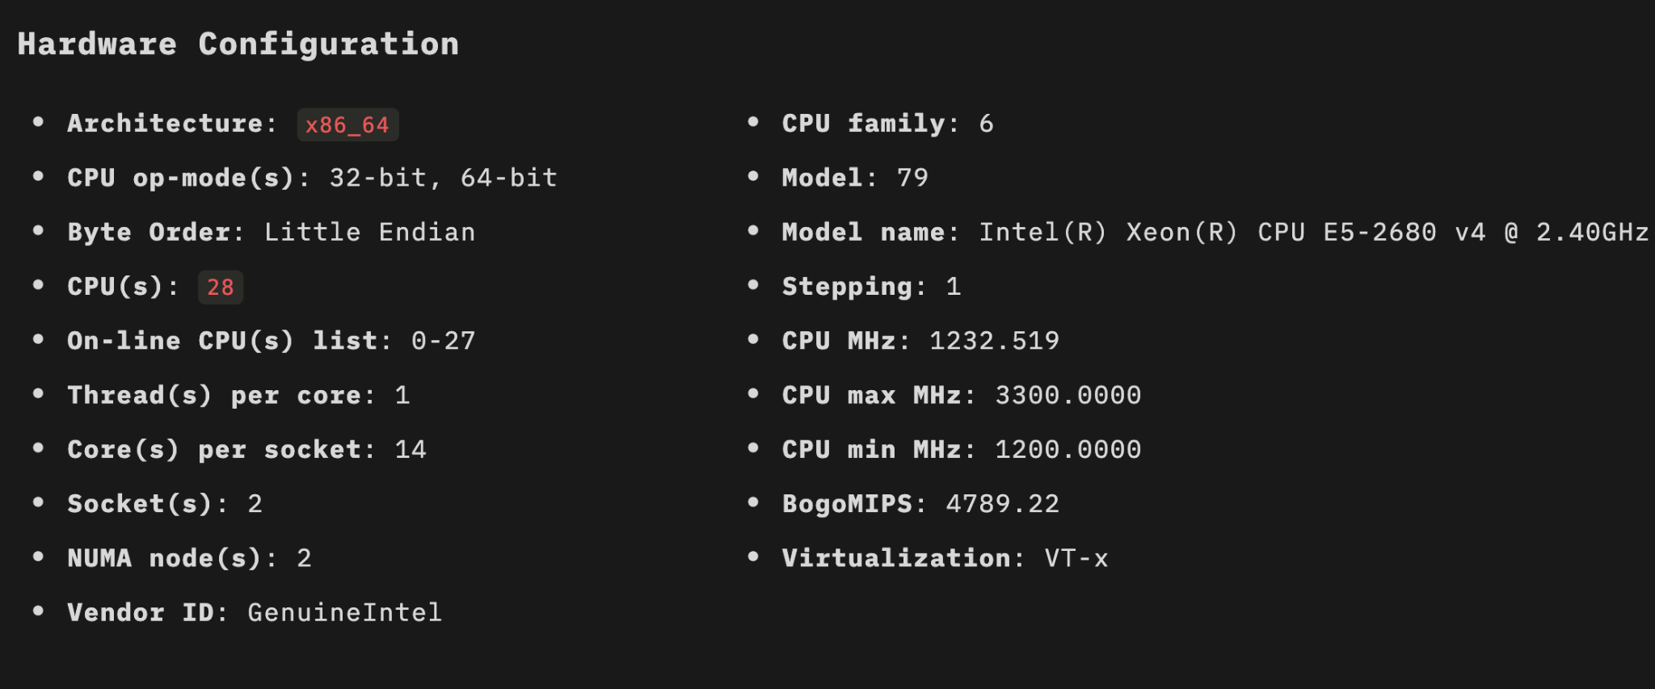
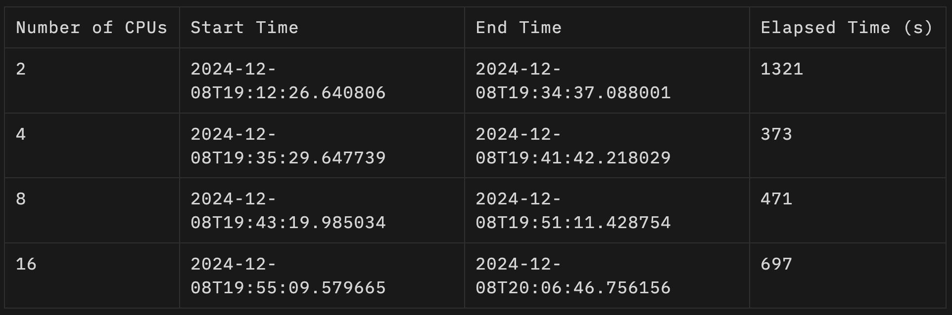
Metrics Tracked:
- Average Training Loss: Average loss across all recorded steps for each configuration.
- Elapsed Time: Total time taken for the training process.
- Speedup: The improvement in training time compared to the baseline configuration.

Slide 23
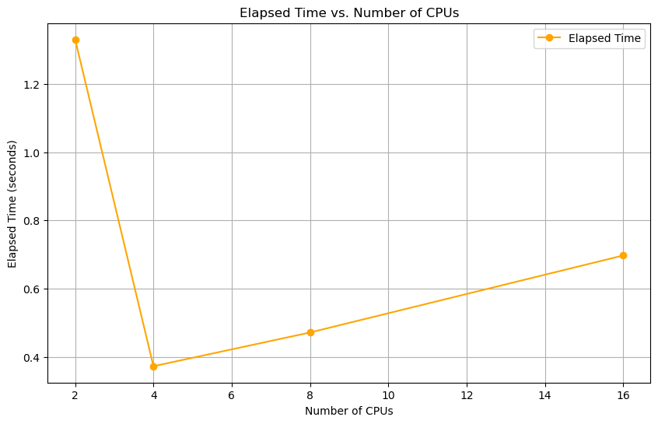

Slide 24
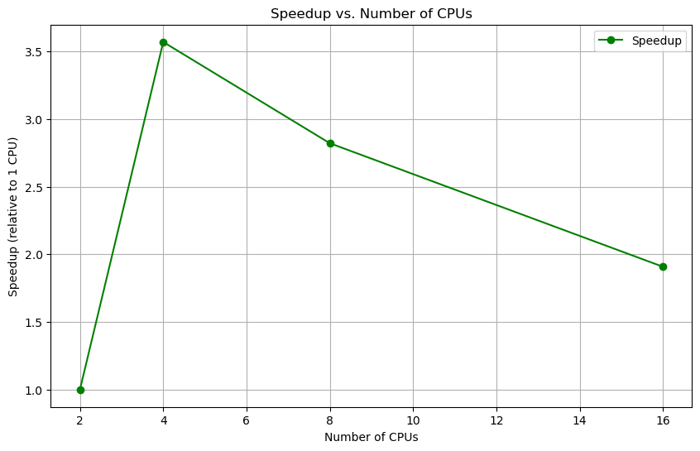

Slide 25
Analysis of Multi-CPU Training Metrics
Elapsed Time vs. Number of CPUs
- Observation: Elapsed time drops significantly from 2 to 4 CPUs, showing efficient scaling. Beyond 4 CPUs, the time increases slightly due to synchronization overhead.
- Insight: 4 CPUs achieve the best training speed with minimal coordination costs.
Speedup vs. Number of CPUs
- Observation: Speedup peaks at 4 CPUs. Adding more CPUs reduces efficiency due to increased communication overhead.
- Insight: Performance gains diminish as overhead dominates for higher CPU counts.
Key Takeaways
- Optimal Configuration: 4 CPUs provide the best balance between speed and efficiency.
- Limitation: Synchronization overhead impacts scalability beyond 4 CPUs.

Slide 26
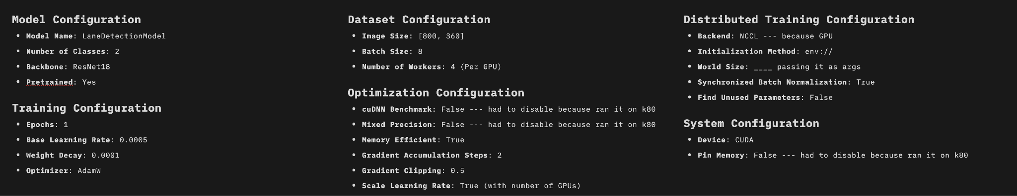
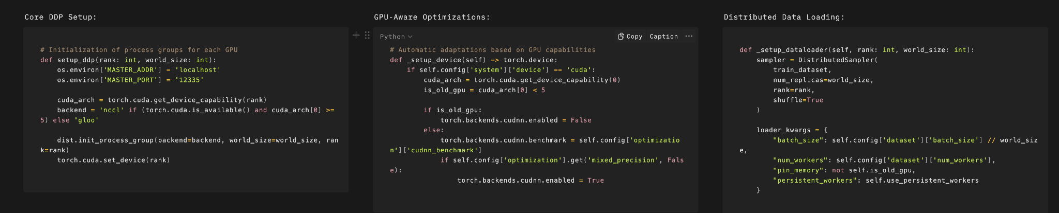
Distributed GPU Training Using PyTorch
Notes:
Gradient accumulation is a technique that enables training deep learning models with larger effective batch sizes by splitting the process into sequential steps. This approach is particularly valuable when dealing with memory constraints on GPUs.
The K80 lacks Tensor Cores, which are essential for hardware acceleration of mixed precision operations
While the K80 can technically use FP16 data types, attempting to use mixed precision on K80 actually results in slower performance rather than speedup

Slide 27
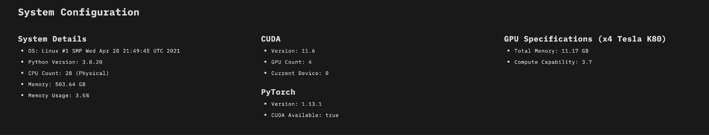
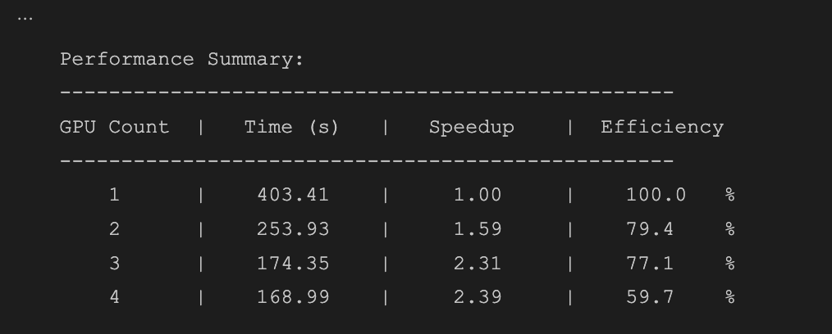
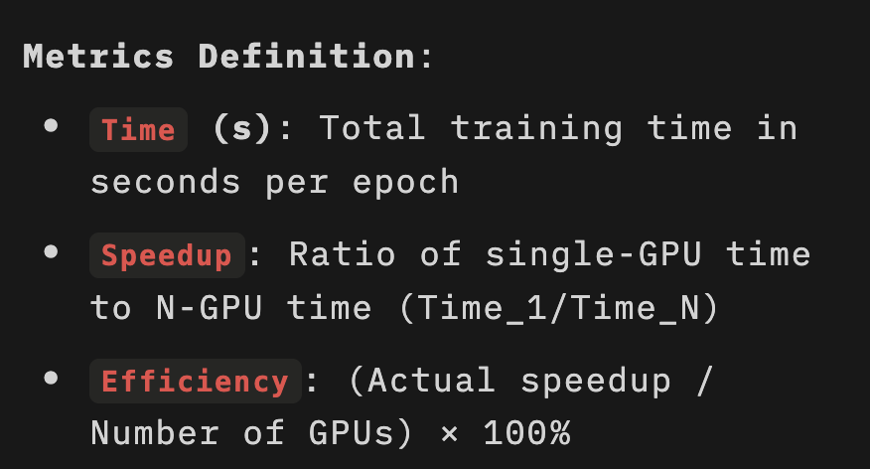

Slide 28
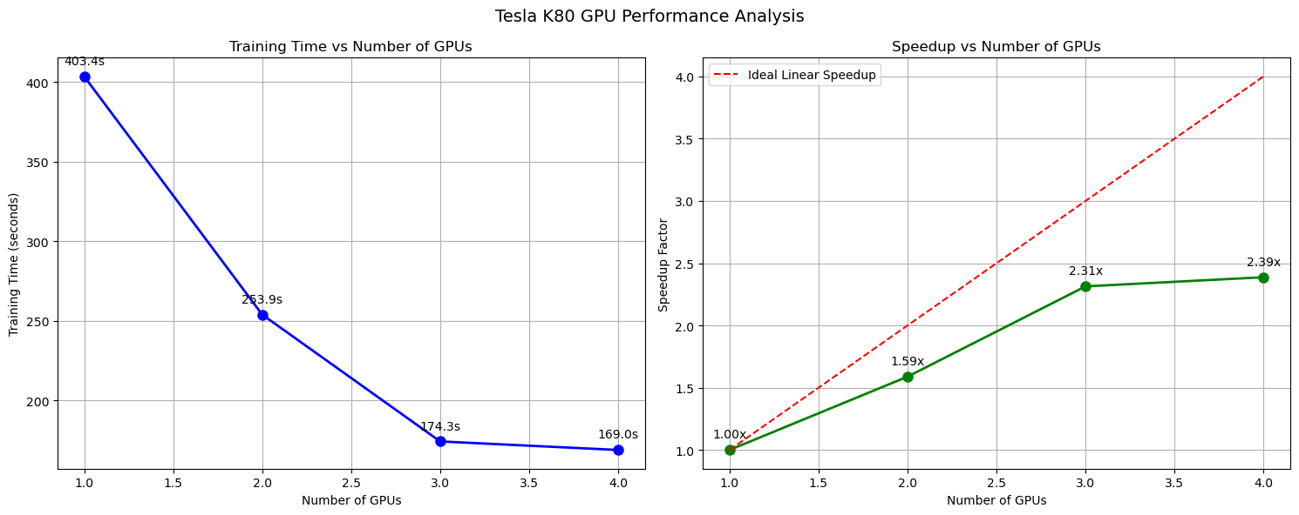

Slide 29
1. Training Time:
- Single GPU: 403.41s (baseline)
- 4 GPUs: 168.99s (58% reduction)
- Diminishing returns after 3 GPUs
2. Speedup Scaling:
- 2 GPUs: 1.59x
- 3 GPUs: 2.31x
- 4 GPUs: 2.39x
- Sub-linear scaling indicates communication overhead
3. Parallel Efficiency:
- 2 GPUs: 79.4% (good parallelization)
- 3 GPUs: 77.1% (maintained efficiency)
- 4 GPUs: 59.7% (significant drop)
- Efficiency loss likely due to:
- Inter-GPU communication overhead
- Resource contention
- Load balancing issues
Key Insight: Optimal performance at 3 GPUs balancing speedup vs efficiency. Adding 4th GPU provides minimal benefit (only 3% additional speedup) with 17.4% efficiency loss.
Notes:
Primary Causes of Speedup Reduction
Communication Overhead
As more GPUs are added, the time spent on inter-processor communication increases significantly1
The communication-to-computation ratio becomes less favorable with each additional processor1
Synchronization Costs
Multiple GPUs must coordinate and wait for each other, introducing delays1
Resource contention increases with more processors, leading to wait times
Amdahl's Law states that the maximum potential speedup is limited by the fraction of the program that must run sequentially3. This law demonstrates why we see diminishing returns as we add more processors - the sequential portion becomes the bottleneck3
Performance Impact Factors
Load Balancing Issues
Uneven distribution of work across processors reduces efficiency4
Dynamic workloads can create bottlenecks where faster processors wait for slower ones4
Resource Contention
Multiple processors competing for shared resources creates bottlenecks3
Memory access patterns and cache utilization become more complex2

Slide 30
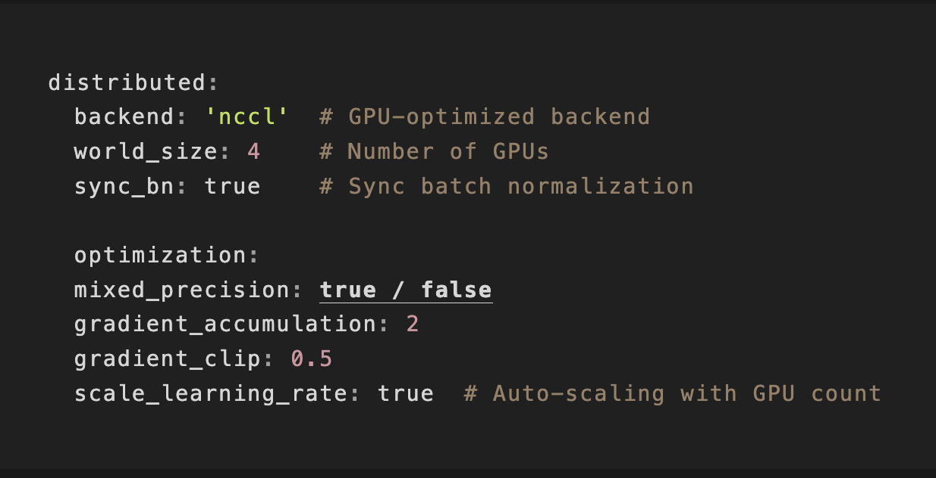
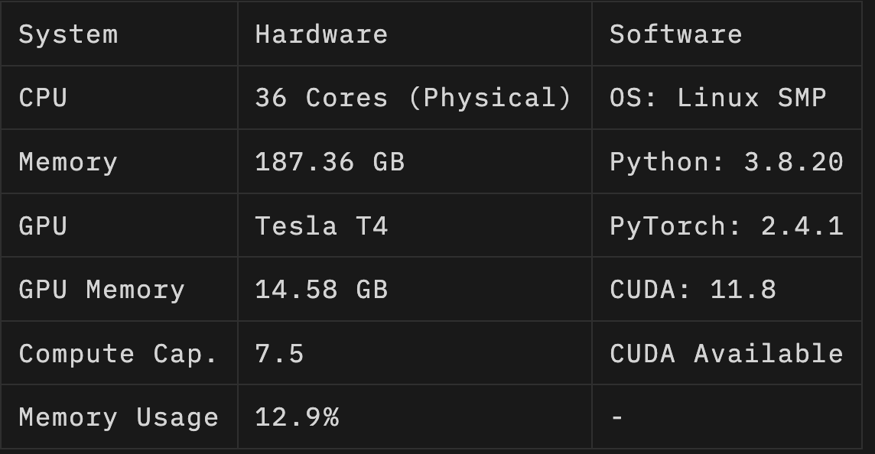
Mixed Precision Comparison on T4

Slide 31
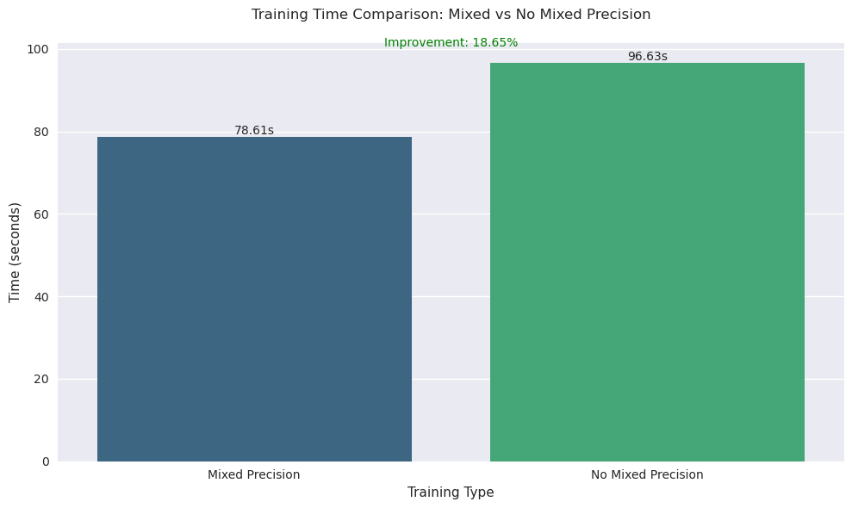
Notes:
Why Mixed Precision is Faster
Mixed precision training achieves faster performance through several mechanisms:
Reduced Memory Bandwidth: Half-precision operations require only half the memory bandwidth, speeding up data transfer operations5
Faster Computations: Math operations run significantly faster in reduced precision, especially on GPUs with Tensor Core support5
Efficient Resource Usage: Mixed precision can provide up to 3x overall speedup on arithmetically intense model architectures5
Technical Implementation
The speed improvement is achieved by:
Converting weights to FP16 (16-bit floating point) for faster computation
Calculating gradients in lower precision
Converting gradients back to FP32 (32-bit floating point) for numerical stability
Updating the original weights with the scaled gradients6

Slide 32
References
Christofel. (2024, January 30). Advanced Fast & Accurate Lane Detection using RESA. https://www.kaggle.com/code/christofel04/advanced-fast-accurate-lane-detection-using-resa
Papers with Code - Robust Lane Detection through Self Pre-training with Masked Sequential Autoencoders and Fine-tuning with Customized PolyLoss. (2023, May 26). https://paperswithcode.com/paper/robust-lane-detection-through-self-pre
ZJULearning. (n.d.). GitHub - ZJULearning/resa: Implementation of our paper “RESA: Recurrent Feature-Shift Aggregator for Lane Detection” in AAAI2021. GitHub. https://github.com/ZJULearning/resa
Christofel. (2024, January 30). Advanced Fast & Accurate Lane Detection using RESA. https://www.kaggle.com/code/christofel04/advanced-fast-accurate-lane-detection-using-resa
Papers with Code - Robust Lane Detection through Self Pre-training with Masked Sequential Autoencoders and Fine-tuning with Customized PolyLoss. (2023, May 26). https://paperswithcode.com/paper/robust-lane-detection-through-self-pre
ZJULearning. (n.d.). GitHub - ZJULearning/resa: Implementation of our paper “RESA: Recurrent Feature-Shift Aggregator for Lane Detection” in AAAI2021. GitHub. https://github.com/ZJULearning/resa
TuSimple. (2021, November 22). Kaggle. https://www.kaggle.com/datasets/manideep1108/tusimple/

Slide 33
Thank you

